Slide 1

Old Models with New Tricks: Bridging the Gap in Bureau of Public Roads (BPR) Functions with A Cross-Resolution Perspective of Theoretical Fundamentals and Emerging Applications
Xuesong (Simon) Zhou, PhD, (xzhou74@asu.edu)
School of Sustainable Engineering and the Built Environment
Arizona State University

Slide 2
Outline
I. Introduction
Brief overview of the importance of volume-delay functions (VDFs) in transportation planning
Explanation of the limitations of the static BPR function
What are needed for today’s evaluation of emerging technologies? Avs capacity, congestion duration, time dependent arrival and departure
II. Fundamental challenges in transportation planning and flow-based control in the modern era
Overview of the changing transportation landscape and its impact on planning and control
Identification of the need for new approaches to VDF modeling
III. Revitalizing old models with new tricks
Explanation of the approach to modernizing VDF modeling
Discussion of specific techniques for improving VDF accuracy and responsiveness
IV. Case studies
Presentation of real-world examples
Analysis of the results achieved through modernized VDF modeling
V. Future directions
Overview of the potential for continued development and refinement of VDF modeling techniques
Discussion of the role of VDFs in shaping the future of transportation planning and control
VI. Conclusion
Summary of key points

Slide 3
Brief overview of the importance of volume-delay functions (VDFs) in transportation planning
In standard static traffic assignments (STAs)
average travel times are usually modeled as positive, nonlinear, and strictly increasing functions of flow volumes, or more precisely, a volume-to-capacity ratio (V/C).
Basic parameters
free-flow travel time and the practical capacity of the link.
One widely used VDF is the BPR function, which uses a fourth order polynomial based on the V/C ratio.
Spiess (1990), Davidson (1966, 1978), and Akcelik (1978, 1991) based on considerations of many factors, such as random delay and reasonable sensitivity, for extremely low and large V/C ratios.

Slide 4

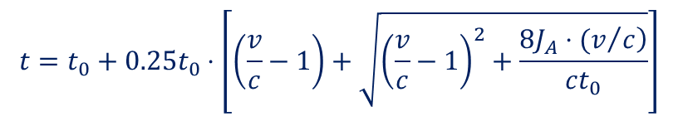
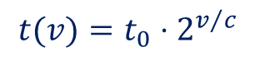
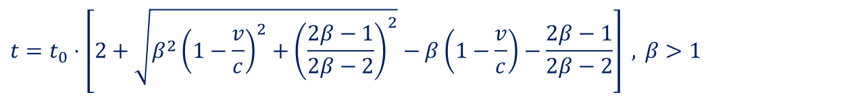
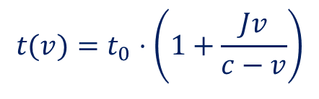
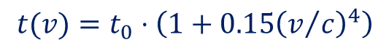
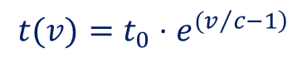
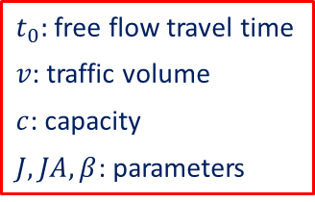
Volume-Delay Function (VDF)
Typical volume-delay function
Chicago Area Transportation Study (1963):
Smock (1963):
BPR (1964):
Davidson (1966):
Spiess (1990):
Akcelik (1991):
$$t(v)=t_{0}⋅2^{v/c}$$
$t_{0}:$free flow travel time
$v$: traffic volume
$c$: capacity
$J, JA, β$: parameters
$$t(v)=t_{0}⋅e^{{(v}/{\left.c−1\right)}}$$
$$t(v)=t_{0}⋅\left(1+0.15{\left(v/c\right)}^{4}\right)$$
$$t(v)=t_{0}⋅\left(1+\frac{Jv}{c−v}\right)$$
$$t=t_{0}⋅\left[2+\sqrt{β^{2}{\left(1−\frac{v}{c}\right)}^{2}+{\left(\frac{2β−1}{2β−2}\right)}^{2}}−β\left(1−\frac{v}{c}\right)−\frac{2β−1}{2β−2}\right] , β>1$$
$$t=t_{0}+0.25t_{0}⋅\left[\left(\frac{v}{c}−1\right)+\sqrt{{\left(\frac{v}{c}−1\right)}^{2}+\frac{\left.8J_{A}⋅(v/c\right)}{ct_{0}}}\right]$$
Notes:
J determines the degree of curvature of the function

Slide 5
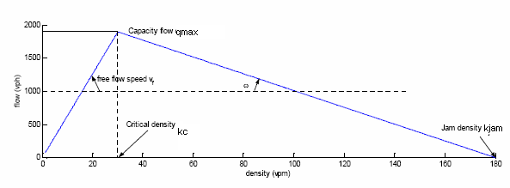
Volume-delay function (VDF)
BPR volume-delay function
Widely used in static traffic assignment
Fail to capture queue evolution, building-up, propagation, dissipation
Fail to represent a bottleneck with low flow but high travel time

Slide 6
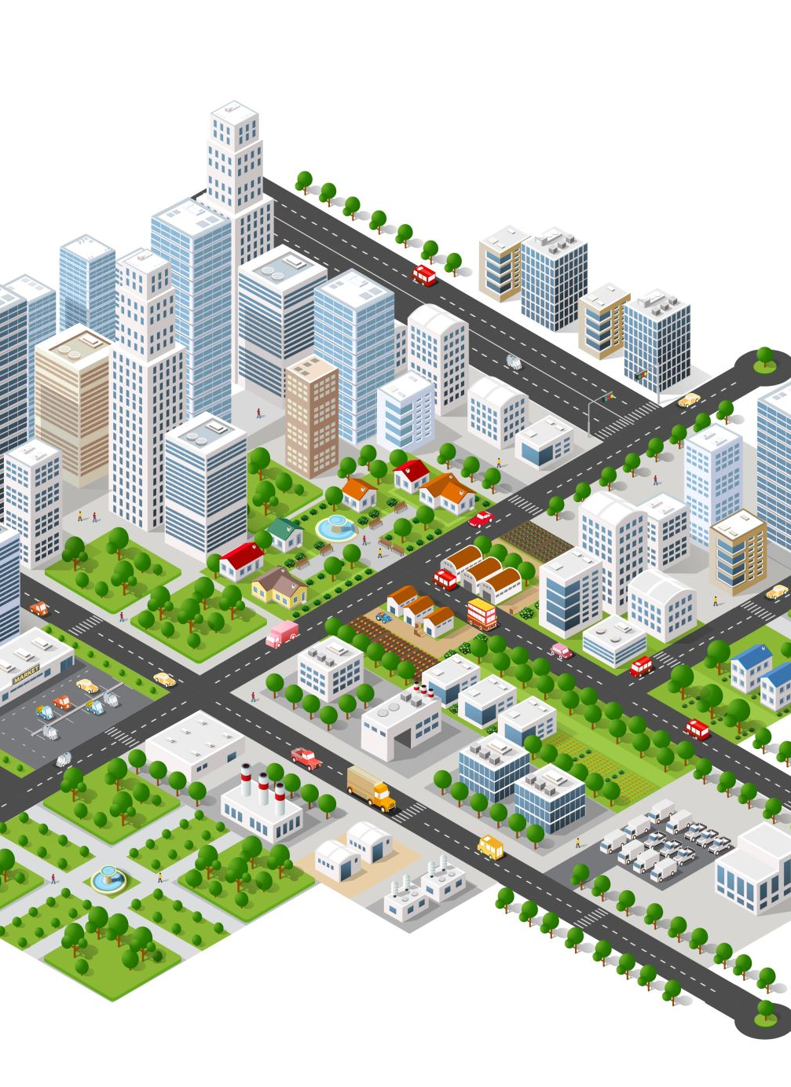
Network Traffic Flow Models
Functional requirements
Capture queue building-up, propagation, dissipation
Represent multiple origin-destination flow
Freeway merge and diverge
Arterial intersections (signal, stop signs, yield signs, no control)
Evaluation Criteria
Theoretically rigorous
Numerically reliable
Computationally efficient

Slide 7
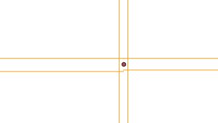
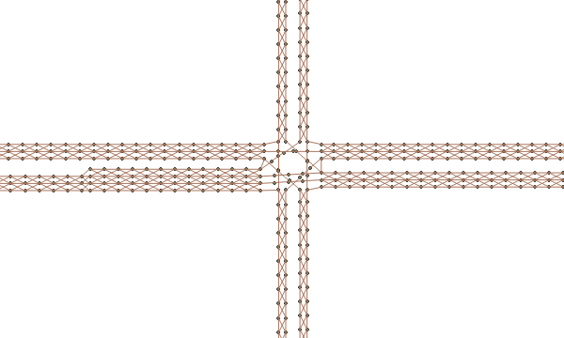
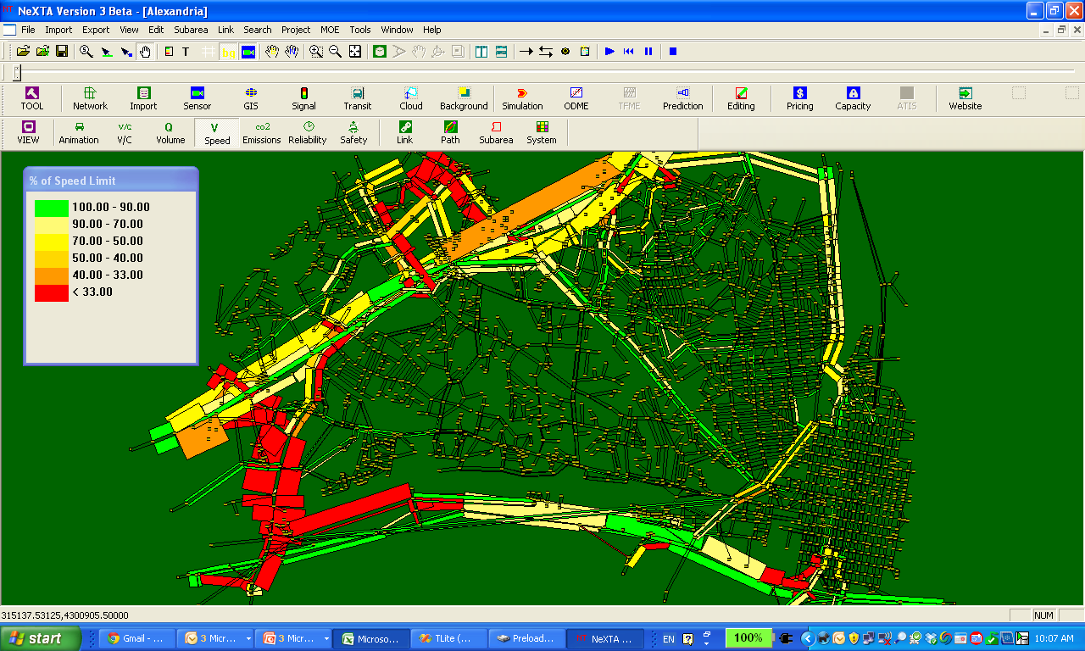
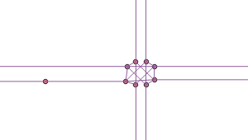
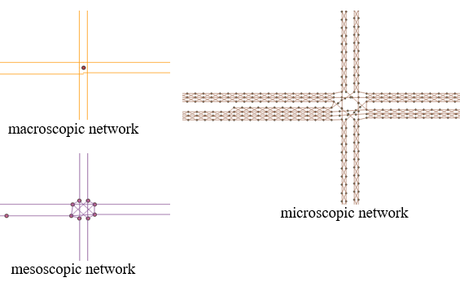
Open-source Free Software Package for Network Modeling
macroscopic network
OSM2GMNS (55K downloads)
converts OpenStreetMap (OSM) data into the General Modeling Network Specification (GMNS) format
DTALite: Open-source computational engine (C++)
Light-weight and agent-based DTA
Simplified kinematic wave model (Newell)
Simplified car follow modeling (Newell)
Built-in OD demand matrix estimation (ODME) program
Emission prediction (light-weight MOVES interface)
microscopic network
mesoscopic network

Slide 8
Challenges in the STA and DTA
Static traffic assignment
computational efficiency
easy for implementation
can’t capture traffic flow dynamics
can’t describe queue evolution
can’t be used for oversaturated traffic conditions
volume over capacity or demand over capacity?
Dynamic traffic assignment
capture traffic flow dynamics
describe queue evolution
point queue or physical queue
CTM- or LTM-based model
high input-detail burden
computational inefficiency

Slide 9
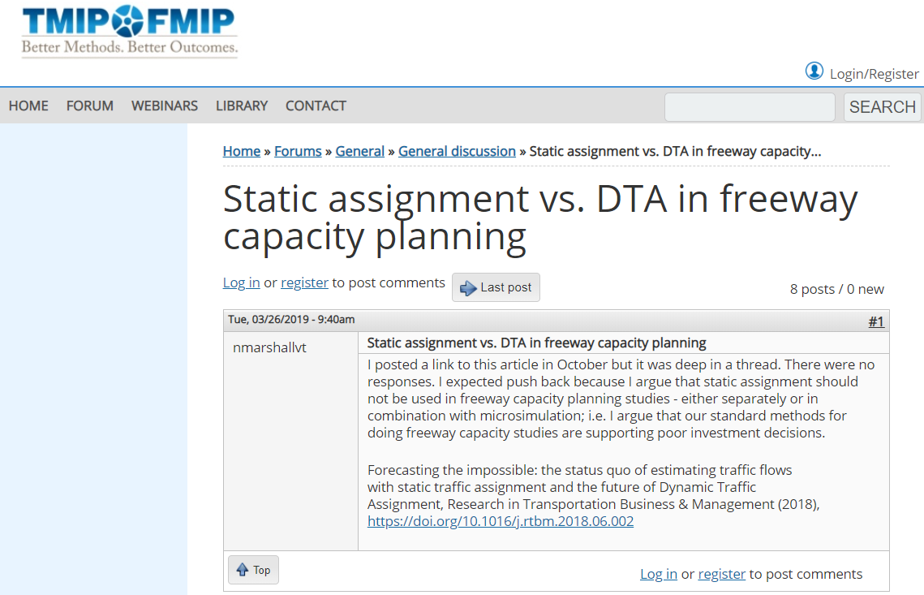
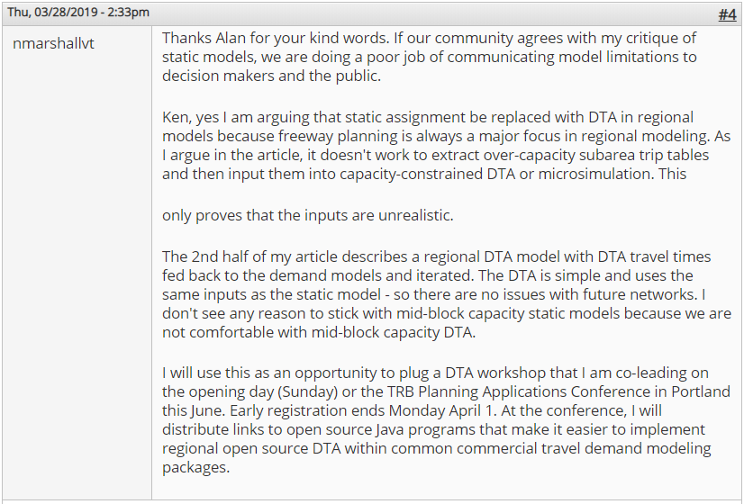
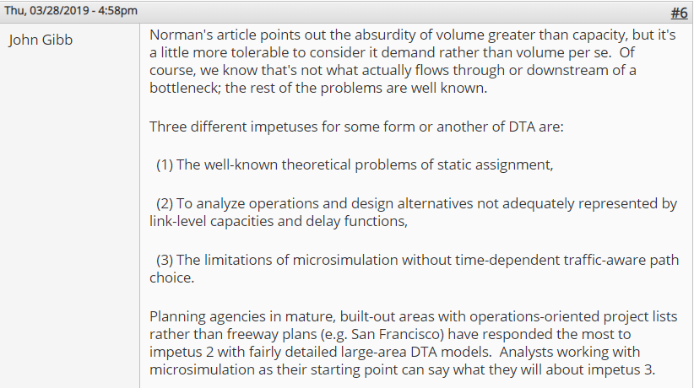
Discussion in TMIP: STA vs DTA
“… I argue that static assignment should not be used in freeway capacity planning studies - either separately or in combination with microsimulation…”
“… it doesn't work to extract over-capacity subarea trip tables and then input them into capacity-constrained DTA or microsimulation …”
“Is there a non-microsimulation DTA that's better than STA? (Some DTAs have theoretical problems of their own, e.g. unreasonable FIFO violation.)”
“Is it good enough to be a replacement for STA as part of a full-region demand-equilibrium model?”
“Since all models are wrong but some are useful, what's better or good enough depends; more detail is not always better.”
“… but a high input-detail burden upon humans under limited budgets and schedules can make such a model less useful and more wrong than a simpler model, particularly for future scenario evaluation…”

Slide 10
Discussion in TMIP: STA vs DTA
Our perspectives:
Bottleneck discharge rate
Highway capacity
Queue evolution: Deterministic fluid approximation vs stochastic m/m/1
Queue-oriented travel time performance function

Slide 11
Goals
(1) We aim to provide a systematic review of Link Performance Functions to conduct a gap analysis related to FD, queueing analysis, and volume-delay functions.
(2) We aim to review VDF-related research to better connect/explore the disconnect between practical deployment with theoretical fundamentals, under undersaturated and oversaturated traffic conditions.
(3) We also examine how VDF can be adapted to handle the progressive emergence of CAV and the considerations of transportation policies with other green transportation modes

Slide 12
II. Challenges in transportation planning and flow-based control in the modern era

Slide 13
Identification of the need for new approaches to VDF modeling
The main steps of developing and calibrating VDF models can be summarized as follows.
(1) Quantify and calibrate road capacity based on the FD models.
(2) Identify existing congestion bottleneck characteristics such as congestion period and average waiting time.
(3) Develop and calibrate one or more volume-delay functional forms while recognizing the probabilistic distributions of underlying capacity, demand and travel time measures.
(4) Embed the VDFs in the traffic assignment program and network/policy design.
(5) Derive other measures of effectiveness (MOE) based on assigned volume and speed for short-term and long-term planning tasks.

Slide 14
The fundamental challenges of VDFs/LPFs
Fundamental challenges
(1) Volume and capacity definitions | What are the best practices for defining volume and capacity in VDFs/LPFs to ensure accurate representation of traffic conditions and system performance?
(2) Dynamic delay nature and aggregation level of traffic systems | What are the best practices for defining demand and delay in VDFs/LPFs to ensure accurate representation of traffic conditions and system performance, and how can we address the variability around the delay and potential dependencies on other factors?
(3) Analysis period and time profiles | How can we enhance VDFs and LPFs to account for variations in chosen analysis periods and the presence of multiple time profiles within that period?
(4) Dynamic queuing modeling for uninterrupted flow and interactions delays for interrupted flow | What improvements can be made to VDFs/LPFs to accurately represent both uninterrupted (motorway) and interrupted flow (intersections) with varying dynamics and delay mechanisms?
(5) Context factors and traffic composition | How can we incorporate various context factors, such as the presence of other traffic (pedestrians, cyclists), parallel parking, driveways, and traffic composition, into VDFs/LPFs to improve their performance and accuracy?
(6) Emerging applications and calibration process of VDF | How can VDFs evaluate the impact of different driving behaviors and automation levels on traffic flow, and how can we obtain VDF parameters that accurately capture the underlying traffic flow characteristics on a network with varying traffic conditions, to ensure accurate prediction of travel time delay?
(7) Future directions in cross-resolution VDF research | How the VDFs/LPFs can tackle transportation challenges and improve transportation performance with advanced modeling techniques and emerging data sources?
Overview of the changing transportation landscape and its impact on planning and control

Slide 15
An overarching view of the different stakeholders and their measures related to VDFs in the development of new transportation systems.
Stakeholders | Stakeholder interests | System-wide metrics | Individual user-oriented performance
Autonomous vehicles | Capacity enhancement Reducing incidents | Ridesharing Penetration rates | Reduced delays Improved safety
Mobility as a service | MaaS cost Accessibility | Total end-to-end service time MaaS availability | Delays for MaaS vehicles Service time windows and fares Detour factor for shared ride Punctuality
Public transportation and multimodal transit | System efficiency Public equity Sustainability | Total driving time Congestion | Delays at bottlenecks Mean travel time Travel time reliability
Energy | Energy cost Travel demand | Fuel consumption Mode choice | Price for energy Vehicle hours of delay
Emissions and health | Market share Pollution | High vehicular emissions Traffic congestion | Vehicle miles traveled or vehicle hours traveled Drivers’ anxiety

Slide 16
Summary of the VDF-related multiresolution modeling for emerging technologies.
Stakeholders | Micro | Meso | Macro
Autonomous vehicles | link kinematic waves to capacity link car following to reaction time traffic control | control inflow rate link capacity to discharge rate queue evolution | departure time choice incoming flow rate shape and pattern
Mobility as a service | choice pick up service time | point to point travel time time-dependent discharge rate | control inflow rate curves control departure rates curves
Public transportation and multimodal transit | departure time choices | generate time-varying travel time travel distribution | trip pattern rush hour
Energy | vehicle specific power (VSP) | time-dependent speed profile | link average speed from BPR to fluid approximation queue
Emissions and health | control freeway ramp metering arterial traffic signal coordination | dynamic route shifts traffic dynamics scheduling | estimating the spatial distribution of travelers and mode shifts trip patterns

Slide 17
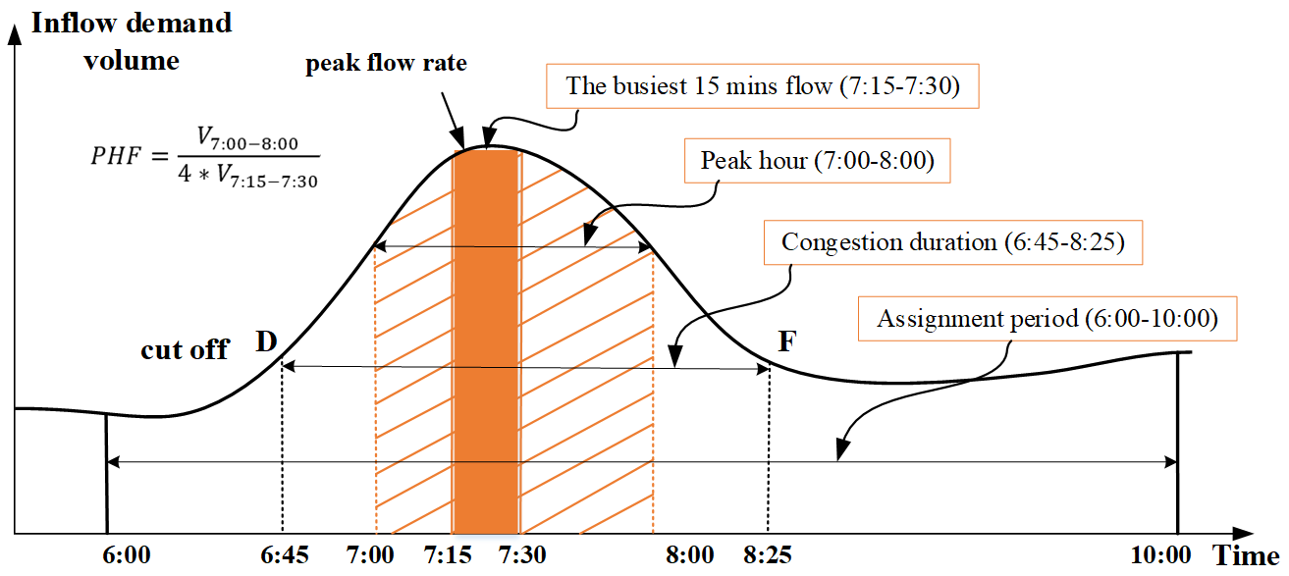
Connections between the link performance function and macroscopic traffic flow fundamental diagram
Mapping traffic observations to assignment periods, congestion periods and peak flow rates
Typically, a peak hour factor (PHF) is used to convert the peak hour traffic volume into the flow rate representing the busiest 15 minutes of the rush hour in the assignment period (e.g., AM or PM).
Based on speed data, one can determine which hours of traffic surpass capacity, and this hour is typically defined as the peak hour.
There are essential differences between congestion duration and heaviest volume hour: all the hours in which inflow demand volumes exceed capacity have been identified in congestion duration.
The relationship between peak flow rate, congestion duration, and assignment period
Point D: Breakdown
Point F: Recovery flow

Slide 18
III. Revitalizing old models with new tricks

Slide 19
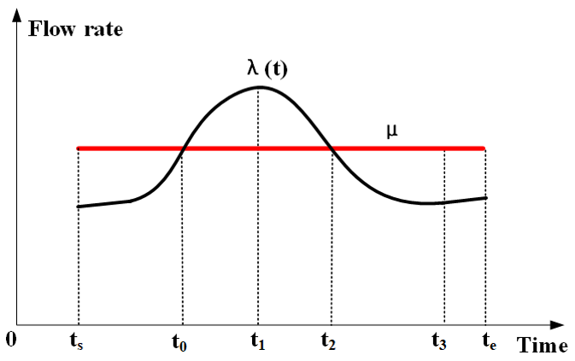
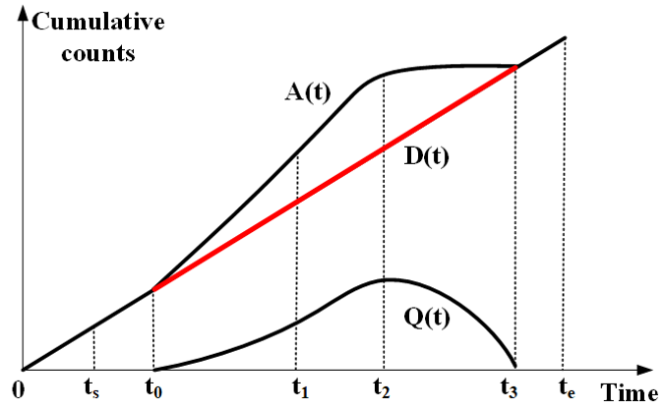
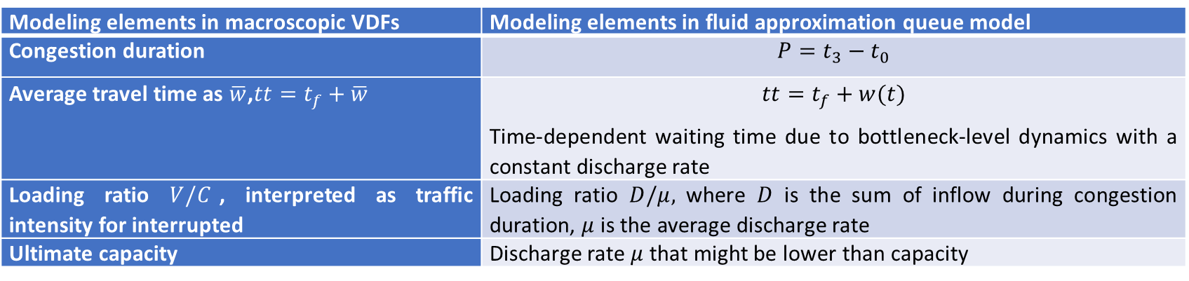
Connections between the link performance function and queueing models
Connections between macroscopic VDFs and the fluid approximation queue model
Modeling elements in macroscopic VDFs | Modeling elements in fluid approximation queue model
Congestion duration | $$P=t_{3}−t_{0}$$
Average travel time as $\overline{w}$,$tt=t_{f}+\overline{w}$ | $$tt=t_{f}+w(t)$$ Time-dependent waiting time due to bottleneck-level dynamics with a constant discharge rate
Loading ratio $V/C$, interpreted as traffic intensity for interrupted | Loading ratio $D/μ,$ where $D$ is the sum of inflow during congestion duration, $μ$ is the average discharge rate
Ultimate capacity | Discharge rate $μ$ that might be lower than capacity

Slide 20
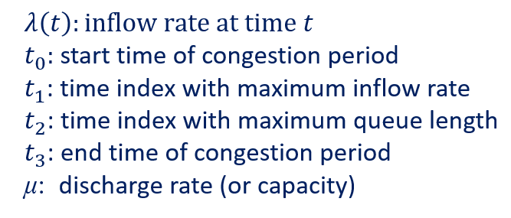
Newell’s fluid polynomial queueing model with quadratic arrival rates
$$λ\left(t\right)=λ\left(t_{1}\right)−ρ{(t−t_{1})}^{2}$$
Closed-form solution of delays
Key Parameters:

Slide 21
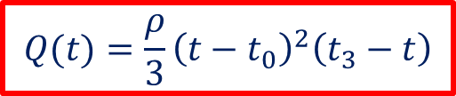
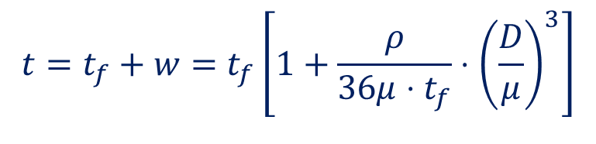
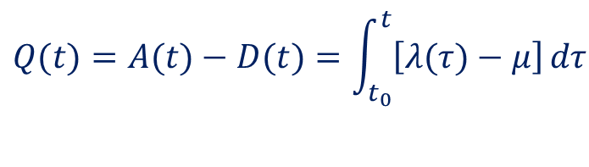
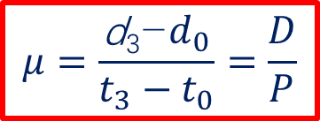
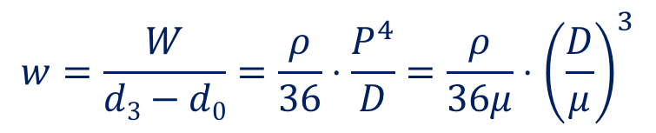
Newell’s fluid polynomial queueing model with quadratic arrival rates
$$λ\left(t\right)=λ\left(t_{1}\right)−ρ{(t−t_{1})}^{2}$$
Queue length:
$$\begin{matrix}Q(t)=A(t)−D(t)=\int_{t_{0}}^{t}{\left[λ(τ)−μ\right]}dτ \\ \\ \end{matrix}$$
$$Q(t)=\frac{ρ}{3}{\left(t−t_{0}\right)}^{2}\left(t_{3}−t\right)$$
Average travel time function:
$$t=t_{f}+w=t_{f}\left[1+\frac{ρ}{36μ⋅t_{f}}⋅{\left(\frac{D}{μ}\right)}^{3}\right]$$
Average delay:
$$w=\frac{W}{d3−d0}=\frac{ρ}{36}⋅\frac{P^{4}}{D}=\frac{ρ}{36μ}⋅{\left(\frac{D}{μ}\right)}^{3}$$
$$μ=\frac{\text{d}\text{3}\text{−}d_{0}}{t_{3}−t_{0}}=\frac{D}{P}$$

Slide 22
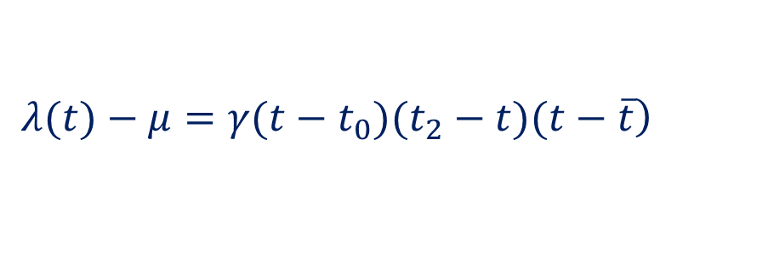
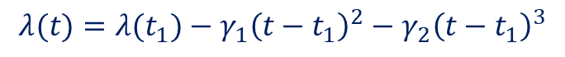
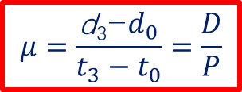
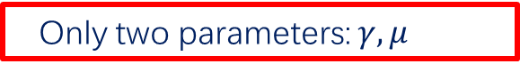
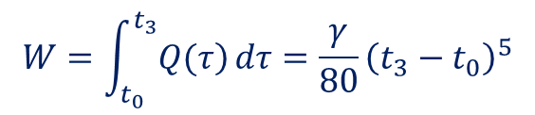
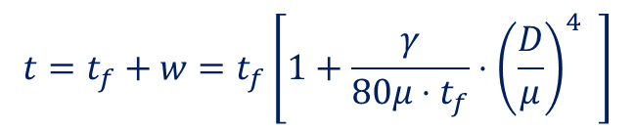
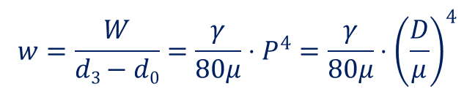
Extended fluid polynomial queueing model with cubic arrival rates
Cubic form:
$$λ(t)=λ(t_{1})−γ_{1}{\left(t−t_{1}\right)}^{2}−γ_{2}{\left(t−t_{1}\right)}^{3}$$
Total delay: W
$$W=\int_{t_{0}}^{t_{3}}{\left.Q(τ\right)}dτ=\frac{γ}{80}{\left(t_{3}−t_{0}\right)}^{5}$$
Average delay:
$$w=\frac{W}{d3−d0}=\frac{γ}{80μ}⋅P^{4}=\frac{γ}{80μ}⋅{\left(\frac{D}{μ}\right)}^{4}$$
$$μ=\frac{\text{d}\text{3}\text{−}d_{0}}{t_{3}−t_{0}}=\frac{D}{P}$$
Average travel time function:
$$t=t_{f}+w=t_{f}\left[1+\frac{γ}{80μ⋅t_{f}}⋅{\left(\frac{D}{μ}\right)}^{4} \right]$$
Only two parameters: $γ,μ$

Slide 23
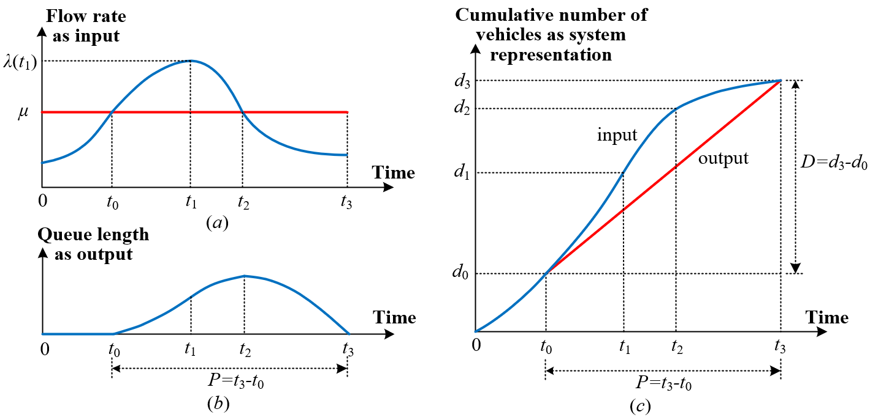
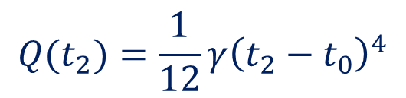
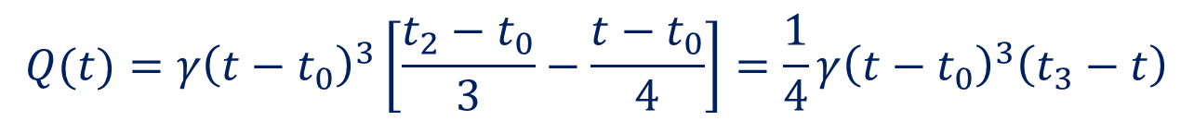
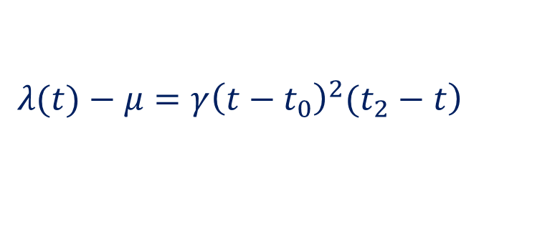
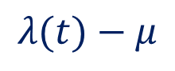
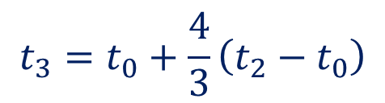
Polynomial Arrival Fluid Queue Model
Cubic form:
Assumption: The derivative of inflow rate
at time t₀ is zero, i.e., t₀ = $\overline{t} .$
Factored form of :
$$λ(t)−μ$$
$$\left.λ(t)−μ=γ{\left(t−t_{0}\right)}^{2}(t_{2}−t\right)$$
Queue length:
$$Q(t)=γ{\left(t−t_{0}\right)}^{3}\left[\frac{t_{2}−t_{0}}{3}−\frac{t−t_{0}}{4}\right]=\frac{1}{4}γ{\left(t−t_{0}\right)}^{3}\left(t_{3}−t\right)$$
Maximum queue length:
Queue dissipating time:
$$Q(t_{2})=\frac{1}{12}γ{\left(t_{2}−t_{0}\right)}^{4}$$
$$t_{3}=t_{0}+\frac{4}{3}\left(t_{2}−t_{0}\right)$$

Slide 24
Connections between the link performance function and queueing models
Connections between macroscopic VDFs and the fluid approximation queue model
How polynomial arrival queue (PAQ) models represent different system performance characteristics based on a parsimonious set of critical parameters?
(1) In a given analysis period [ts,te], inflow demand λ(t) can be represented by the congestion duration P and the queue discharge rate μ during the congestion period [t0,t3].
(2) The PAQ is able to provide a closed-form of average delay consistent with the time-dependent queueing delay.
(3) There are subtle but important differences between the macroscopic parameters of V/C in a VDF and parameters D/μ.
(4) The time-dependent travel time in the underlying fluid approximation queue model should satisfy the FIFO property and capacity constraints.

Slide 25
Queue based volume-to-delay function (QVDF)
Basic concepts
Volume-to-capacity (V/C) ratio vs. inflow demand-to-capacity (D/C) ratio
Congestion duration, cut-off-speed, and average discharge rate
Comparison among PAQ models, BPR function, and QVDF
Linking Polynomial Arrival Queue with Macroscopic Volume-Delay Function

Slide 26
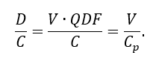
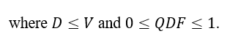
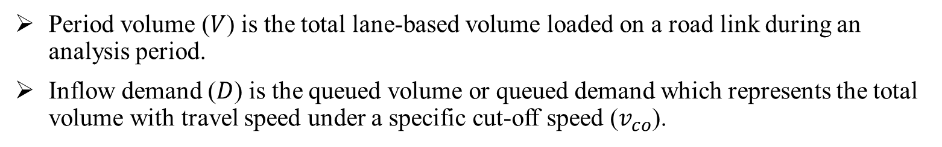
Queue based volume-to-delay function (QVDF)
Period volume ($V$) is the total lane-based volume loaded on a road link during an analysis period.
Inflow demand ($D$) is the queued volume or queued demand which represents the total volume with travel speed under a specific cut-off speed ($v_{co}$).

Slide 27
Queue based volume-to-delay function (QVDF)
PAQ models, congestion duration $P:$the peak period from $t_{0}$ to $t_{3}$ (i.e., $P=t_{3}−t_{0}$), where arrival rate $λ(t)$ is higher than the average discharge rate $μ$.
The relationship among time-dependent speed, arrival rates, cut-off speed, and average discharge rate

Slide 28
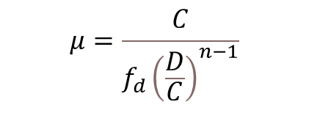
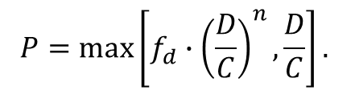
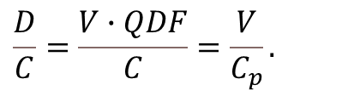

Linking Polynomial Arrival Queue with Macroscopic Volume-Delay Function
Major steps towards queue-oriented link performance function QVDF:
$$\frac{D}{C}=\frac{V∙QDF}{C}=\frac{V}{C_{p}}.$$
$$P=\max\left[{f_{d}∙\left(\frac{D}{C}\right)}^{n},\frac{D}{C}\right].$$
$$μ=\frac{C}{{f_{d}\left(\frac{D}{C}\right)}^{n−1}}$$
$$w_{t_{2}}=\frac{L}{v_{t_{2}}}−\frac{L}{v_{co}}=\frac{L}{v_{co}}∙\left(\frac{v_{co}−v_{t_{2}}}{v_{t_{2}}}\right)=\frac{L}{v_{co}}∙MSR=\frac{L}{v_{co}}{∙f_{p}∙\left(P\right)}^{s}$$
$$γ=64μ∙\frac{L}{v_{co}}∙{f_{p}\left(P\right)}^{s−4}$$
$$v\left(t\right)=\frac{L}{\frac{L}{v_{co}}+w(t)}$$

Slide 29
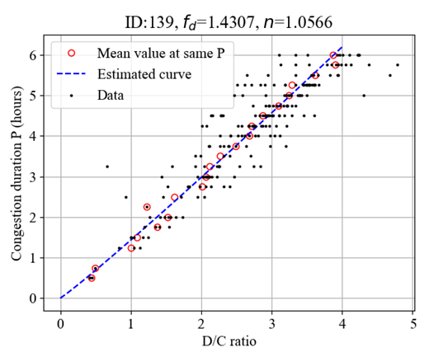
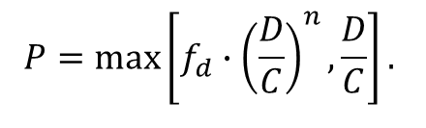
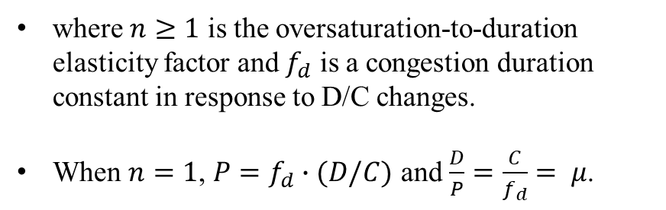
Linking Polynomial Arrival Queue with Macroscopic Volume-Delay Function
Assumption: power function between congestion duration $P$ and traffic intensity in terms of the D/C ratio.
The average discharge rate should be less than the capacity, i.e., $μ≤C$. To ensure the capacity constraint, the following condition should be satisfied: $D/C≤P$
$$P=\max\left[{f_{d}∙\left(\frac{D}{C}\right)}^{n},\frac{D}{C}\right].$$
where $n≥1$ is the oversaturation-to-duration elasticity factor and $f_{d}$ is a congestion duration constant in response to D/C changes.
When $n=1$, $P=f_{d}∙(D/C)$ and $\frac{D}{P}=\frac{C}{f_{d}}= μ$.

Slide 30
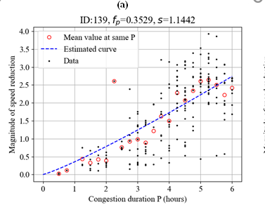



Linking Polynomial Arrival Queue with Macroscopic Volume-Delay Function
The magnitude of speed reduction (MSR):
$$MSR=\frac{v_{co}−v_{t_{2}}}{v_{t_{2}}}$$
We further establish a relationship between congestion duration $P$ and $MSR$
$$MSR={f_{p}∙\left(P\right)}^{s}$$
Where $s≥1$ is the duration-to-speed reduction elasticity factor and $f_{p}$ is an MSR reduction constant in response to changes of congestion duration.
The boundary condition is satisfied for $MSR=0$ as $P=0$ and $v_{t_{2}}=v_{co}$. When $P=1$, $f_{p}$ represents the baseline value for speed reduction magnitude, $\frac{v_{t_{2}}}{v_{co}}$ $=\frac{1}{1+f_{p}}$.

Slide 31




Linking Polynomial Arrival Queue with Macroscopic Volume-Delay Function
we create a connection between $w_{t_{2}}$(i.e., the longest delay at $t_{2}$ compared with $v_{co}$) and P
$$w_{t_{2}}=\frac{L}{v_{t_{2}}}−\frac{L}{v_{co}}=\frac{L}{v_{co}}∙\left(\frac{v_{co}−v_{t_{2}}}{v_{t_{2}}}\right)=\frac{L}{v_{co}}∙MSR=\frac{L}{v_{co}}{∙f_{p}∙\left(P\right)}^{s}$$
Time-dependent speed can be derived as follows:
$w(t)=\frac{γ}{4μ}∙{\left(t−t_{0}\right)}^{2}∙{\left(t−t_{3}\right)}^{2}$.
$$v\left(t\right)=\frac{L}{\frac{L}{v_{co}}+w(t)}$$

Slide 32

Connections of link performance functions and traffic flow models

Slide 33






Connections of link performance functions and traffic flow models
realistic waiting time
triangular FD
Polynomial arrival rate
Fluid queue
By Newell
FD with different functional forms
Queue related VDF
FD
PAQ
Q-VDF
Conventional VDF
CVDF
TD outflow rates
Capacity constrained models
CC-Lagrangian relaxation
flow rate <= cap
Realistic flow rates with capacity breakdown
breakdown
Residual queuing models
Link transmission
queue spillback
RQ Model QS
node model
density
LTM
Hard capacity constraints
CTM, LTM, PDE
do not allow for residual queues

Slide 34
IV. Case studies

Slide 35
Calibrations
Description of empirical data sets
Data set | Queueing system | Object | Data type and information | Collected time and location
DS1 | Traffic system | Vehicle | Freeway detector data with traffic flow, speed, and occupancy, etc. | Collected from the Northbound direction of I-405 freeway between absolute postmile 8.97 to 14.77 mile in Los Angeles on April, 2019, from 11:00 a.m. to 20:00 p.m.
DS2 | Traffic system | Vehicle | Remote traffic microwave sensor data with the traffic flow, and probe vehicle data with averaged traffic speed, etc. | Collected from the west-third-ring of Beijing City on June 8, 2018, from 6:00 a.m. to 12:00 a.m.
DS3 | Transportation system | Taxi | Taxi trip record data with trip ID, pickup time and location, drop off time and location, etc. | Collected from the Midtown Center of Manhattan to the John F. Kennedy International Airport in New York City on October 2018, provided by the New York City Taxi and Limousine Commission

Slide 36
Calibrations
Areas of the queueing system
DS1: Los Angeles
DS2: Beijing
DS3: New York

Slide 37





Calibrations: DS1 Los Angeles
Data description
Data: flow (q), occupancy (occ), speed (v), detector location, number of lanes
Measurements:
1) Time-dependent physical queue length
2) Time-dependent delay
3) Time-dependent flow rate
$$Qp\left(t\right)=\frac{Q^{v}(t)}{1−\frac{v_{μ}}{v_{f}}}=Observed queue(t)+ε_{queue}$$
$$Observed queue(t)=\sum_{i=1}^{n}{{[k_{it}−k_{c},0]}^{+}∗A_{i}}$$
$${Q^{v}(t)}/μ=Observed delay\left(t\right)+ε_{delay}$$
$$μ=q(τ)+ε_{flow}$$

Slide 38
Calibrations: DS1 Los Angeles
Bottleneck detection with speed contour map
It is clear that the bottleneck is located at Abs=13.51 mile. In this case, we only analyze one single bottleneck with one peak period from t₀ = 13:10 to t₃ = 19:45.

Slide 39



Calibrations: DS1 Los Angeles
Speed and occupancy
The blue curves depict the speed, while the red curves depict the occupancy. We can see that the speed downstream the bottleneck almost keeps stable over 45mile/hour during the peak period, while the speed at the bottleneck and upstream the bottleneck is reduced sharply during the peak period. Similarly, the occupancy downstream the bottleneck almost below 0.11 during the peak period, while the occupancy at the bottleneck and upstream the bottleneck reaches up to 0.25 during the peak period.

Slide 40

Calibrations: DS1 Los Angeles
Flow-occupancy plot
The horizontal axis is the occupancy, while the vertical axis is the flow. The red dots represent the traffic loading process, while the blue dots represent the traffic unloading process. The bottleneck is located on the second row and second column. We can see that the critical occupancy of the queueing system closes to 0.13, which is used to calculated the observed physical queue length for the parameter calibration.

Slide 41

Calibrations: DS1 Los Angeles
Results

Slide 42
Calibrations: DS2 Beijing
Bottleneck detection with speed contour map
It exists the spatial queue spillback and the temporal queue connection phenomena.

Slide 43
Calibrations: DS2 Beijing
Illustration of the two peak period model
It can be used to solve the temporal queue connection problem.

Slide 44

Calibrations: DS2 Beijing
Results

Slide 45


Calibrations: DS3 New York
Bottleneck detection
Midtown, Manhattan
JFK Airport

Slide 46

Calibrations: DS3 New York
Cumulative arrival and departure curves

Slide 47

Calibrations: DS3 New York
Results

Slide 48


Calibrations: Comparison across three regions
Results

Slide 49
Case Study for Queue-VDF
Case study: Individual locations along a freeway corridor in Phoenix, Arizona
7:00-21:00 as one analysis period
Phoenix I-10 freeway corridor and the four detectors

Slide 50
Results
Volume-speed scatters of entire year’s data (from 7:00 to 21:00 ) and calibrated traffic flow model

Slide 51

Results
Calibration results of step 1 calibration that links D/C to congestion duration
Detector ID | The first step calibration |  | The second step calibration, |  | Parameters for BPR-like average speed function
 | $$f_{d}$$ | $$n$$ | $$f_{p}$$ | $$s$$ | $$α$$ | $$β$$
139 | 1.43 | 1.06 | 0.35 | 1.14 | 0.28 | 1.21
84 | 1.37 | 1.14 | 0.23 | 1.64 | 0.21 | 1.87
78 | 1.13 | 1.22 | 0.11 | 2.10 | 0.07 | 2.55
137 | 1.73 | 1.02 | 0.21 | 1.71 | 0.29 | 1.75

Slide 52
Results
Calibration results of step 2 calibration that links congestion duration to the magnitude of speed reduction

Slide 53
Results
Curves between D/C ratio and average speed during congestion duration

Slide 54
Results
Calibrated inflow curvature parameters for different links and weekdays (sorted by D/C ratio)

Slide 55




Results
Observed time-dependent mean speed and estimated speed at detector ID 87 on Monday
Observed time-dependent mean speed and estimated speed at detector ID 87 on Tuesday
Observed time-dependent mean speed and estimated speed at detector ID 87 on Wednesday
Observed time-dependent mean speed and estimated speed at location with detector ID 87 on Thursday

Slide 56



Discussion: Limitation and Calibration challenges
Challenges in calibrating Bureau of Public Roads (BPR) function:
Lack of rigorous definitions for the volume-to-capacity (v/c) ratio
$$u=\frac{u_{f}}{1+α{\left(\frac{v}{c}\right)}^{β}}$$
What is the meaning of the “capacity” is in the v/c ratio?
What is the meaning of the v/c ratio in the BPR function?
What is the relation between the v/c and peak hour factors (PHFs)?
v/c ≥ 1
v/c ≥ 1 might not be empirically observed

Slide 57


Discussion: Limitation and Calibration challenges
Partition the VDF coordinate plane into 3 regimes with speed at capacity $u_{c}$:
Regime A: Observed flow rate with undersaturated state v/c ≤ 1 and uninterrupted free speed $u≥u_{c}$
Regime B: Observed reduced flow rate with saturated state v/c ≤ 1 and reduced speeds $u≤u_{c}$
Regime C: Unobserved but derived “demand” volume with oversaturated state v/c ≥ 1 with reduced speeds $u≤u_{c}$
Three regimes in speed vs. v/c ratio coordinate plane
Mtoi, E. T., & Moses, R. (2014). Calibration and evaluation of link congestion functions: applying intrinsic sensitivity of link speed as a practical consideration to heterogeneous facility types within urban network. Journal of Transportation Technologies.

Slide 58
V. Future directions

Slide 59
Extensions of VDFs for multimodal, multivehicle type and asymmetric interactions
Emerging applications
The primary purpose of applying VDFs in emerging technology is to equilibrate assigned traffic volumes over the urban network by estimating the level of free-flow or congestion conditions at the macroscopic, mesoscopic, or microscopic transportation network analysis level.
 |  | Underlying Methodology
Research Problems | Focus | Fundamental diagram | Queueing theory with a stochastic process | Point queues/bottleneck models | Cell transmission model, simplified KW
Multimodal transportation (rail, air, truck) | Freight flexibility
 | Railway capacity
Public transportation | Bus accessibility
Bike | Congestion in a single path
Pedestrians | Bidirectional pedestrian streams
MaaS | Ridesourcing shared transportation
CAV | Mixed traffic flow
Research problems and underlying methodologies for the development of VDFs considering emerging technologies

Slide 60
Extensions of VDFs for multimodal, multivehicle type and asymmetric interactions
VDFs for CAV transportation
Key References | Traffic flow composition | Fundamental diagram | Volume-delay function at the physical network | Component of cyber-CAV | Wireless communication network
(Levin and Boyles, 2015) | AVs |  | ü
(Levin and Boyles, 2016) | HDVs and AVs | ü | ü
(Olia et al., 2018) | HDVs and AVs | ü
(Lu et al., 2020) | HDVs and AVs | ü |  | ü
(Wang et al., 2021, 2019) | HDVs and CAVs |  | ü | ü
(Abbasi et al., 2022; Abid et al., 2012; Dey et al., 2016; Hu et al., 2017) | V2X |  |  | ü | ü
(Zhao et al., 2019; Zhou and Peeta, 2021) | V2V |  |  | ü
References in connecting performance measures between the physical roadway systems and cyber-CAV systems

Slide 61
Extensions of VDFs for multimodal, multivehicle type and asymmetric interactions
VDFs for CAV transportation
AVs or CAVs could significantly affect future transportation services through enhanced automation and connectivity. As a result, the following questions require further study.
How can hysteresis behavior due to human driving be analyzed in CAV and non-CAV mixed traffic flow conditions?
The development of a VDF for CAVs could involve a multiresolution analytics approach that can aggregate mesoscopic and microscopic results to volume-delay functions from newly available continuous or semicontinuous vehicle location, speed, and acceleration data across different days or months.
(b) How can the capacity and queue discharge be better described under complex situations, uncertain conditions, and complex geometry?
The capacity and queue discharge rate may be increased via shorter intervehicle gaps, improved lane usages, less unnecessary lane-changing, efficient merging, and lane changing.
(c) How can the FD and VDF be improved for mixed traffic flow?
The FD for mixed traffic flow needs to consider the headway distribution CAV penetration, and platooning intensity
Future studies can examine the safety and operational benefits of CAVs in different traffic conditions.

Slide 62

Extensions of VDFs for multimodal, multivehicle type and asymmetric interactions
VDFs for CAV transportation

Slide 63

Extensions of VDFs for multimodal, multivehicle type and asymmetric interactions
VDFs for CAV transportation

Slide 64

Extensions of VDFs for multimodal, multivehicle type and asymmetric interactions
VDFs for CAV transportation

Slide 65
Extensions of VDFs for multimodal, multivehicle type and asymmetric interactions
Multiresolution VDFs for network design
Focused on evaluating various problems related to transportation network design problems. Some key questions need to be considered in future studies.
How can consistent definitions and a unified modeling framework be developed for multiresolution modeling?
Future studies should use an integrated supply-side parameter calibration package with consistent definitions of traffic flow models and macroscopic VDFs.
(b) How can the VDF function be developed to analyze performance on both the demand and supply sides?
Connecting VDFs with available DTA models to account for variable demand and traffic dynamics can be a critical future research direction, especially under a policy of time-dependent congestion pricing.

Slide 66
VI. Conclusion

Slide 67
Summary
With this analytical formulation for the system performance evaluation, we can optimize the system performance jointly through the demand regulation policies and supply building efforts, and make a balance between them quantificationally with isoperformance contours.
In addition to the demand- and supply-side management, we can also actively control the transportation system performance with some control strategies, such as adaptive signal control, dynamic lane-use control, transit signal priority, etc.

Slide 68
Takeaway messages
Alpha and beta have physical meaning as they correspond to arrival and departure curves.
A fluid queue with polynomial arrival rate provides a simplistic and parsimonious way to understand system dynamics.
The queue based VDF model has been successfully applied to real-world statewide models.
Fast computation times enable large-scale scenario planning and management.
Evaluation of emerging technologies should not rely solely on simulation-based studies.
Understanding the true arrival/departure rate, FD shape, and identifying congestion bottlenecks are necessary components of system dynamics in theory.
Optimal control and feedback theories should be utilized to derive analytical, closed-form solutions that capture the behavior of time-dependent delays and different shapes of arrival and departure curves/profiles.
Multiple aggregated supply and demand functionalities exist for different system-wide analyses, such as time-dependent queue dynamics of a multi-modal transportation system.

Slide 69









ASU ITE Student Chapter
Brandon Schaack
Bright Seglah
Portia Lartey
Mayur Patil

Slide 70
Appendix
Virtual queue vs. physical queue

Slide 71
Appendix
Queue spillback

Slide 72
Appendix
Dynamic signal control

